Slide 1
CS 416 Web Programming Security
Dr. Williams
Central Connecticut State University

Slide 2
Programming and Security
Programming Securely To develop code in a secure manner so that the code itself is not a vulnerability that can be exploited by an attacker.
Programming Security To develop code for security-specific functions such as encryption, digital signatures, firewalls, etc.
In this lecture, we look at both sides:
continuing programming securely: some web application security issues and some Java guidelines.
programming security: overview of Java security APIs and trust models.

Slide 3
Overview
Web security issues
Java Security: Coding and Models
Language futures for security

Slide 4
Web security: server-side threats
Access control: should prevent certain files being served.
Complex or malicious URLs
Denial of service attacks
Remote authoring and administration tools
Buggy servers, with attendant security risks
Server-side scripting languages: C or shell CGI, PHP, ASP, JSP, Python, Ruby, all have serious security implications in configuration and execution. File systems and permissions have to be carefully designed. That’s before any implemented web application is even considered. . .

Slide 5
Web programming: application security
Many issues
Input validation: to prevent SQL injection, command injection, other conﬁdentiality attacks.
Ajax: beware client-side validation! Understand metacharacters at every point. Use labels/indexes for hidden values, not values themselves.
Output ﬁltering: Beware passing informative error messages.
Careful cryptography: encryption/hashing to protect server state in client, use of appropriate authentication mechanisms for web accounts

Slide 6
Overview
Web security issues
XSS and SQL injection
Java Security: Coding and Models
Language futures for security

Slide 7
Cross site scripting (XSS)
Inserting code to be run on target server or pages returned by target server
Common way unprotected database inserts
Steal cookies, steal personal info, passwords, etc
See code demo

Slide 8
SQL injection
Inserting SQL to be run in existing SQL calls to database
Common way unprotected database selects, inserts, updates, deletes
Insert/update/delete records, potentially drop tables
Return information you shouldn’t be able to access
See code demo

Slide 9

XKCD

Slide 10
Java Secure Coding Guidelines
Using modiﬁers
Reduce scope of methods and ﬁelds
Beware non-ﬁnal public static (global) variables
Avoid public ﬁelds
Add security checks to public accessors.

Slide 11
Java security extensions
Java Cryptography Extension (JCE)
A Java framework for cryptographic functionality, including message digests, encryption, signing, and X.509 certiﬁcates.
Java Secure Socket Extension (JSSE).
Java Authentication and Authorization Service (JAAS)
Used for “reliable and secure” authentication of users, to determine who is currently executing Java code; and for authorization of users to ensure they have the permissions necessary for desired actions.
Java GSS-API.
Bindings for Generic Security Service API (RFC2853). Used for securely exchanging messages between communicating applications, using various underlying mechanisms (e.g., Kerberos).

Slide 12
Java Cryptography Extension (JCE)
Crypto framework.
A provider plug-in architecture allows multiple simultaneous implementations.
Has algorithm independence
clients don’t need to understand algorithms; abstract “engine” classes provide different services.
Service provider interfaces (SPIs)
added statically or dynamically; clients query installed providers to ﬁnd out supported services. JVM and clients specify preference orders.
Key management is through a “keystore” database.
Different providers may have different formats.
SUN provider implements common formats and proprietary keystore type JKS.
See: javax.crypto, javax.crypto.interfaces, javax.crypto.spec.

Slide 13
JCE cryptography services
A cryptography service is associated with a particular algorithm or type, and manipulates or generates data, keys, algorithm parameters, keystores, or certiﬁcates.
Engine classes include:
MessageDigest generate message digests (MDCs)
Signature sign data and verify digital signatures.
KeyPairGenerator generate public-private key-pair.
CertiﬁcateFactory create certiﬁcates and CRLs.
KeyStore create and manage key databases.
AlgorithmParameters manage parameters for an algorithm.
SecureRandom random or pseudo-random numbers.
Factory methods in engine classes are used to return instances of the class, e.g. Signature.getInstance("SHA1withDSA").

Slide 14
Java Secure Socket Extension (JSSE)
The JSSE is also based on a provider plug-in architecture.
Has a simple structure. Main use is with SSL client sockets, SSL server sockets, and SSL session handles. Sample classes:
SSLSocket socket for SSL/TLS/WTLS protocols
SSLSocketFactory factory for SSLSocket objects
SSLServerSocket sever socket for SSL/TLS/WTLS
· · · Factory factory for SSLServerSockets
SSLSession encapsulation of SSL session
Creating SSL client or server sockets is as easy as creating ordinary Java TCP/IP sockets: each SSL class extends the corresponding ordinary TCP socket class, and provides a few extra hooks for setting security parameters.
See javax.net.ssl, also javax.net and javax.security.cert.

Slide 15
Authentication and Authorization (JAAS)
JAAS has a pluggable architecture; applications independent of underlying authentication methods. Implementation is decided at runtime, in a login conﬁguration ﬁle.
A Subject may have multiple identities; each is a Principal (name). Subjects own public and private credentials (e.g., key material).
To authenticate, a LoginContext object is created, which then consults a conﬁguration to load the required LoginModules. To authenticate a subject the login method is invoked for each module.
Authorization happens when a subject is associated with a thread’s AccessControlContext using the doAs methods for performing actions (java.security.PrivilegedAction.run). Then principal-based entries in the current security policy are used.

Slide 16
JAAS Key elements
Authentication framework
Assertion of identity
Enhanced authorization
Low level of binding between authentication and authorization

Slide 17
Authentication framework
Authentication framework
Policy-based
Generic and abstract
Pluggable, stackable
Key abstractions
Subject - any user of computing
Collection of Principals, credentials
Principal (java.security)
Has a name

Slide 18
Identity and Authorization
Assertion of identity
Avoids incompatible behavior
Lexically scopes identity
Logically associates Subject with current Thread
static Object Subject.doAs(Subject, action)
Enhanced Authorization
Augmentation of current Permission specification
Principal-based
Any authentication with any Permission

Slide 19
JAAS Summary
JAAS extends base security model to accommodate concept of "users"
Pluggable, extensible
Provides a powerful and easy to use extension of application security

Slide 20
Detailed look at JAAS
Java Authentication and Authorization Service
Framework for simplifying and standardizing access to system
Setting up users
Setting up security groups
Setting up security realms
Security realms are crux of JAAS

Slide 21
Security realms cont.
THE biggest production risk is poorly implemented security
Goal eliminate custom programming that leads to inadvertent security holes
Realms framework
Store username, password, security groups
Applications don’t need to implement security
Security is configuration, can be shared across applications

Slide 22
Security realms
Collections of users and related security groups
User can belong to more than one group
Groups define what actions the system will allow the user to do
Unauthenticated access to certain pages
Authenticated users an additional set of pages
Admin ability to perform actions like adding users, or ability to log in to administer application server

Slide 23
JAAS in practice
Goal eliminate custom programming – remember we could control access with filters, but required custom solution and a lot of work to make it flexible enough for all situations. All of these add potential for security holes
Instead implement using JAAS
Admin realm
File realm
Certificate realm
LDAP realm
JDBC realm
Custom realms

Slide 24
Glassfish predefined realms
Admin-realm
Access to Glassfish web console
File realm
Default realm created for controlling access to just authenticated users
Certificate realm
Client side certificate authorization
Need for strong guarantees of users or server connecting

Slide 25
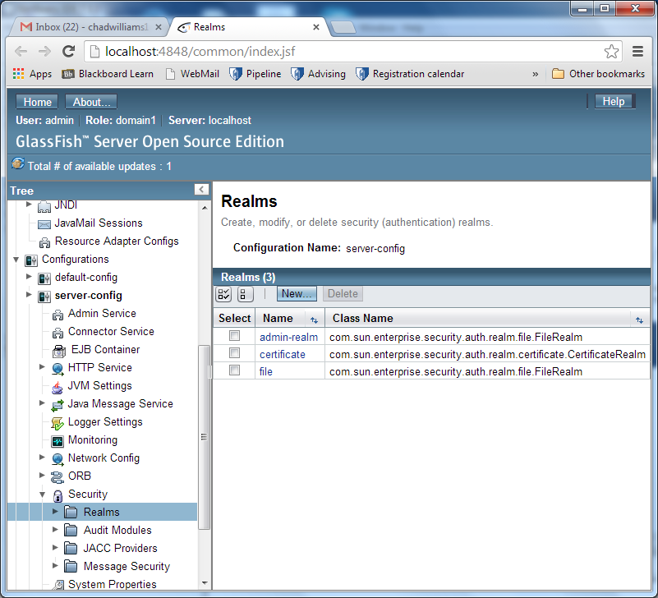
Click
admin-realm

Slide 26
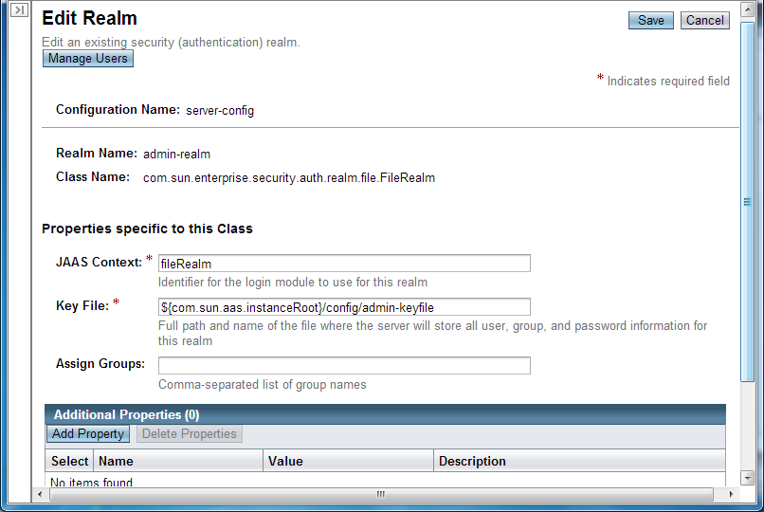
Click manage users

Slide 27
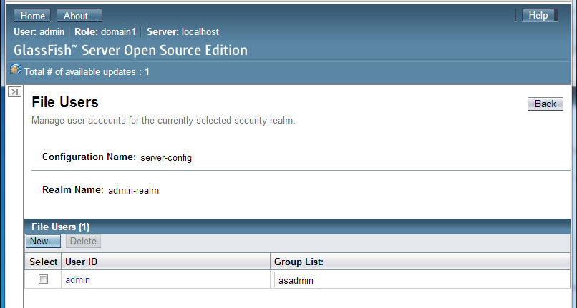
To create a new admin user

Slide 28
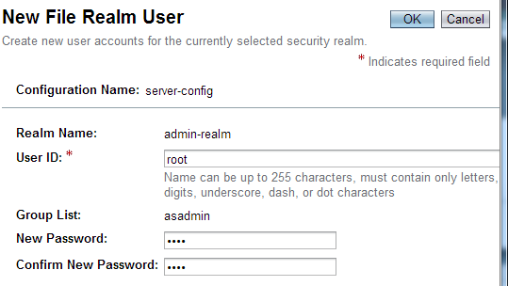
Add user id: root, pass: root
Note after you do this you must configure your server to start up with this user/password

Slide 29
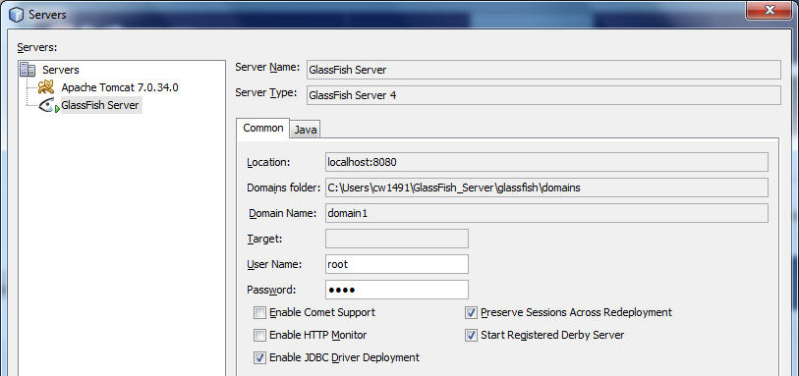
Update Glassfish server properties
Back in NetBeans, right click Glassfish server and select properties
Add
user: root, pass: root

Slide 30
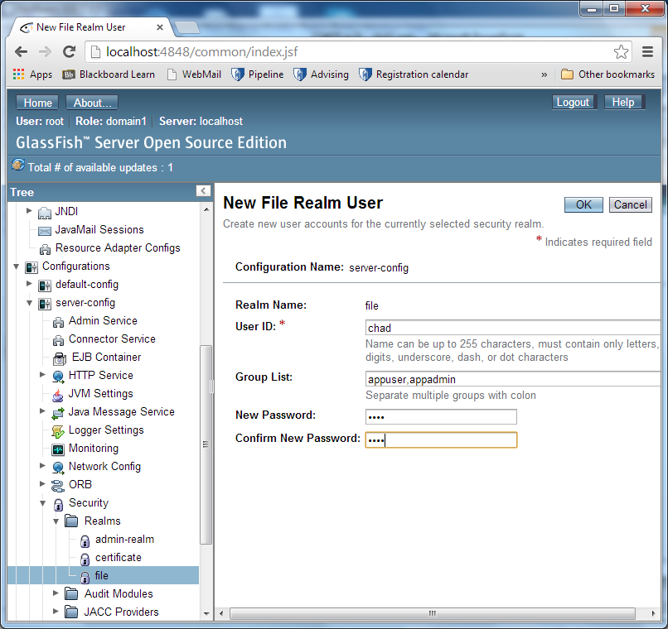
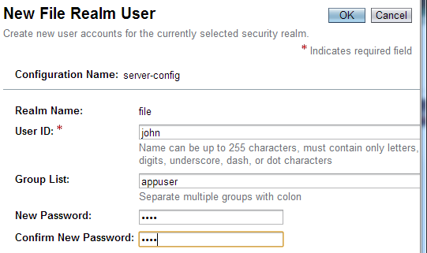
Add 2 users to file realm
appuser,appadmin
appuser

Slide 31
Adding basic authentication
Configure web.xml
<security-constraint>
<display-name>Admin pages</display-name>
<web-resource-collection>
<web-resource-name>Admin pages</web-resource-name>
<description/>
<url-pattern>/admin/*</url-pattern>
</web-resource-collection>
<auth-constraint>
<description/>
<role-name>admin</role-name>
</auth-constraint>
</security-constraint>

Slide 32
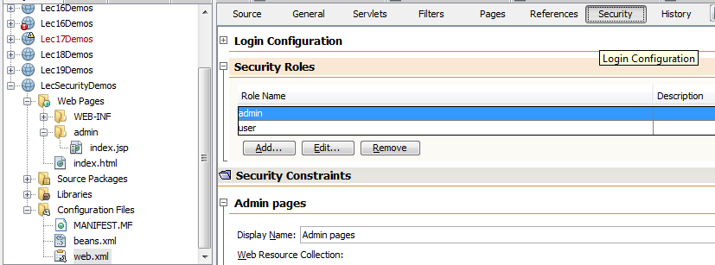
Making use of NetBeans tools
Click security tab
Add web.xml
Add roles

Slide 33
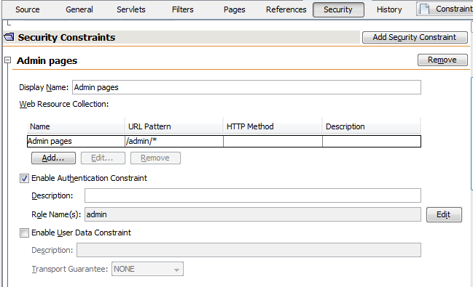
NetBeans tools cont. Add security constraint for admin
Wild card to match all admin pages
Specify role names

Slide 34
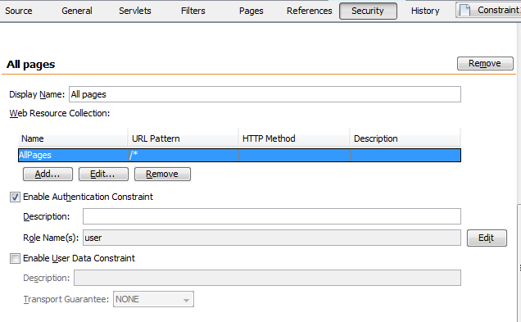
NetBeans tools cont. Add security constraint for all pages

Slide 35
Authentication methods
Auth-method options are BASIC, DIGEST, FORM, and CLIENT-CERT
BASIC – built in pop up authentication – password is sent Base64 encoded…unless this is through HTTPS this isn’t much better than sending password in the clear
DIGEST – built in pop up authentication…password is sent as MD5 digest, means the password itself cannot be recovered
Both have very serious drawback logout/session invalidation not effective as browser caches login information. If you return to a page where you must be authenticated it will log you in again.

Slide 36
Authentication methods cont.
Auth-method options are BASIC, DIGEST, FORM, and CLIENT-CERT
FORM – Specify page (HTML, JSP, XHTML) with form that collects and sends user name, and password. Values in form will be automatically validated against specified security realm. Password sent in the clear unless HTTPS used
CLIENT-CERT – uses client side certificates to authenticate user (more on this later)

Slide 37
Specifying authentication method
For BASIC and DIGEST authentication:
<login-config>
<auth-method>DIGEST</auth-method>
<realm-name>file</realm-name>
</login-config>

Slide 38
Adding form based authentication
<login-config>
<auth-method>FORM</auth-method>
<realm-name>file</realm-name>
<form-login-config>
<form-login-page>/login.jsp</form-login-page>
<form-error-page>/loginError.jsp</form-error-page>
</form-login-config>
</login-config>
<form action="j_security_check" method="POST">
User<input type="text" name="j_username"/><br/>
Pass<input type="pass" name="j_password"/><br/>
<input type="submit" value="Login"/>
</form>

Slide 39
Implementing logout
To force user to reauthenticate you invalidate the session (shown in servlet):
if (request.getSession(false) != null) {
request.getSession(false).invalidate();//remove session.
}
if (request.getSession() != null) {
request.getSession().invalidate();//remove session.
}
response.sendRedirect("index.html");

Slide 40
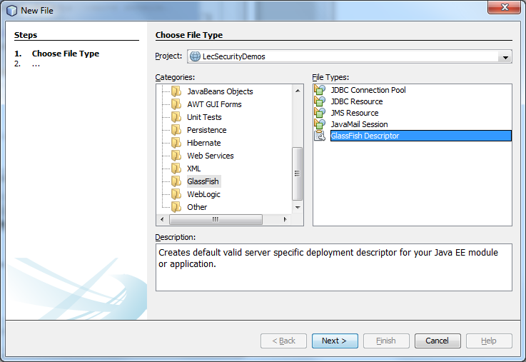
Link user roles to defined realms –define config file
Add new GlassFish descriptor
Note: Book refers to creating sun-web.xml, with newer versions of JAAS descriptor is specific to application server (i.e. GlassFish, WebLogic, etc.)

Slide 41
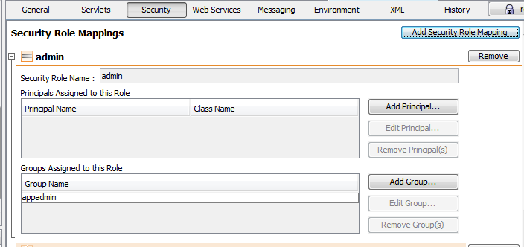
Link user roles to defined realms
Role defined in web.xml
JAAS security realm

Slide 42
HTTPS
Important security note, while input type “pass” masks input submission is sent in the clear
Always have any login page through HTTPS
Specifying HTTPS required in web.xml:
<security-constraint>
<user-data-constraint>
<transport-guarantee>CONFIDENTIAL</transport-guarantee>
</user-data-constraint>
….
</security-constraint>

Slide 43
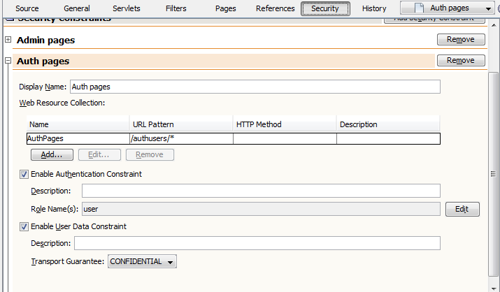
HTTPS – NetBeans tools (web.xml)
Enable
Change to CONFIDENTIAL

Slide 44
Configuring production HTTPS
By default GlassFish uses self-signed certificate, thus the warning you see when you access the https pages
For a production environment you would need to get your certificate signed by a trusted certificate authority (currently minimum about $400)
WARNING before you start messing with certificates
Go into your C:\Users\cw1491\GlassFish_Server\glassfish\domains\domain1\config
Directory and make a backup copy of cacerts.jks and keystore.jks
Playing with keystores is very finicky and if you get one step wrong you won’t be able to start your server back up

Slide 45
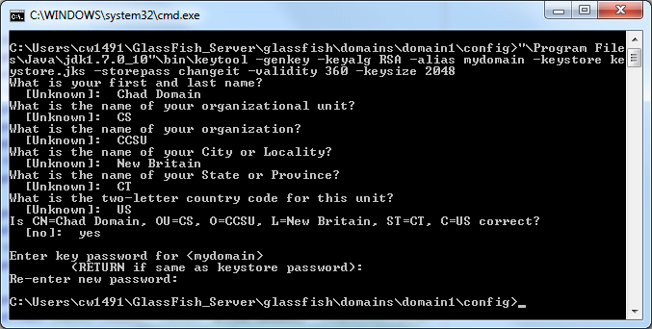
Certificate generation
Create the certificate in the domain config dir.
C:\Users\cw1491\GlassFish_Server\glassfish\domains\domain1\config>"\Program Files\Java\jdk1.7.0_10"\bin\keytool -genkey -keyalg RSA -alias mydomain -keystore keystore.jks -storepass changeit -validity 360 -keysize 2048
Note default password for GlassFish key store

Slide 46
Create certificate signing request
Generate a certificate signing request (CSR)
keytool -certreq -alias mydomain -keystore keystore.jks -file mydomain.csr
Send to Verisign or the like and pay to have them sign it

Slide 47
Installing production certificate
Install it in the keystore:
The “mydomain” above is the nickname you will need to use to reference the certificate in GlassFish
Open GlassFish_Server\glassfish\domains\domain1\config\domain.xml
Perform a global replace of “s1as” with “mydomain”
Restart GlassFish
keytool -import -trustcacerts -alias mydomain -file mydomain.crt -keystore keystore.jks

Slide 48
Certificate realm
Uses client-side certificates for authentication
Not useful for general web application, but advantageous when additional security wanted
Server to server connections
Tight control over user base – corporation issues certificates to employees for accessing corporate intranet remotely
Eliminates risk of hacker getting in through password alone
Certificates signed by company, if computer with certificate gets compromised certificate is revoked

Slide 49
Certificate realm cont.
To create client certificates:
keytool -genkey -v -alias selfsignedkey -keyalg RSA -storetype PKCS12 -keystore client_keystore.p12 -storepass password
Install it in the browser
Usually in browser’s advanced tab under encryption something like “manage certificates”
Import the generated “.p12” file
Export to format that GlassFish can import:
keytool -export -alias selfsignedkey -keystore client_keystore.p12 -storetype PKCS12 -storepass password -rfc selfsigned.cer
keytool -export -alias selfsignedkey -keystore client_keystore.p12 -storetype PKCS12 -storepass password -file selfsigned.cer
Import into GlassFish
keytool -import -file selfsigned.cer -keystore cacerts.jks -storepass changeit

Slide 50
Certificate realm cont.
Previous steps will establish certificates signed by themselves as a trusted certificate authority (not something you want to do in a production environment, but convenient for development)
Result is client-side certificates sent from the browser are trusted implicitly i.e. require no additional verification of user other than presenting their certificate

Slide 51
Configuring client-certificate access
In web.xml
<login-config>
<auth-method>CLIENT-CERT</auth-method>
<realm-name>certificate</realm-name>
</login-config>
This has the effect of GlassFish asking the client for a certificate for authorization when the client requests a protected page
On the client side the way this typically works is browser will prompt you to pick a certificate you have installed which should be used for authentication

Slide 52
Configuring client-certificate access
Any page that requires certificate based authentication must be accessed via HTTPS so security constraints should be set to CONFIDENTIAL as described earlier

Slide 53
Configuring client-certificate access
Modify glassfish-web.xml
<context-root>/certificaterealm</context-root>
<security-role-mapping>
<role-name>user</role-name>
<principal-name>CN=Chad Williams, OU=CS, O=CCSU, L=New Britain, ST=CT, C=US</principal-name>
</security-role-mapping>
You can get the principal name by calling:
keytool -printcert -file selfsigned.cer
Then copying the “issuer” that gets printed

Slide 54
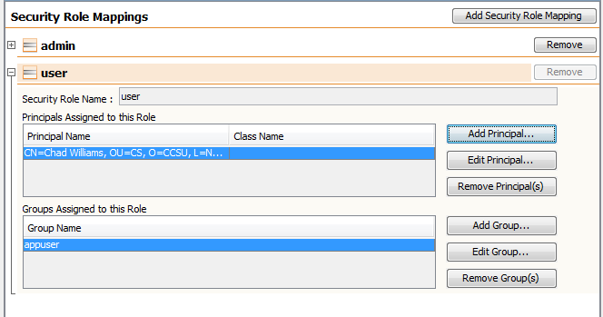
GlassFish wizard

Slide 55
Weaknesses of file and certificate
Both the previous methods file realm, certificate realm provide very secure authentication suitable for a production environment, but have weaknesses
File realm – authentication against application server properties
Difficult to maintain
Limits authentication to applications that can use app server for authentication
Certificate realm – authentication requires client side certificates which isn’t practical for most applications

Slide 56
Single sign-on realms
Most production environments have moved or are migrating from rather than having a different login for each system using a single authentication source
LDAP (Lightweight Directory Access Protocol)
Database
Both sources are widely used and fairly easy to maintain
LDAP has advantages when database access not needed by an application otherwise

Slide 57
Defining LDAP realms
Through admin console create new realm
Class name is: com.sun.enterprise.security.auth.realm.ldap.LDAPRealm
JAAS context is how the realm will be referenced in glassfish config file
Directory is URL for directory server
Base DN is the base distinguised name (DN) to be used in searching for user data

Slide 58
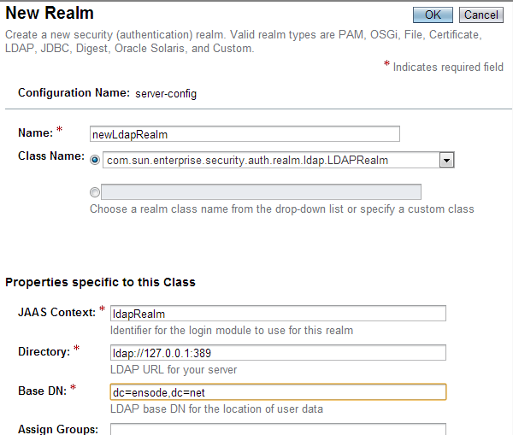
GlassFish admin console

Slide 59
LDAP realms cont.
To use new realm mapping created in glassfish-web.xml
Users and roles in LDAP database can be mapped to principals and groups in that xml
Authentication method must be BASIC or FORM

Slide 60
JDBC realm example setup
More on this…

Slide 61
JDBC password
You never want to store a password in the database (or elsewhere) in plain text.
If system is ever compromised may help attacker break into other sites or systems
Because of this password expected as MD5 hash (which is 32 characters long)
Result is if you want to write to field such as when you create a new user you need to hash the field first

Slide 62
Creating MD5 hash
String password = "myPass";
MessageDigest msgDigest = MessageDigest.getInstance("MD5");
byte[] bs;
msgDigest.reset();
bs = msgDigest.digest(password.getBytes());
StringBuilder sBuilder = new StringBuilder();
for (int i=0;i<bs.length;i++){
String hexVal = Integer.toHexString(0xFF & bs[i]);
if (hexVal.length()==1){
stringBuilder.append("0");
}
stringBuilder.append(hexVal);
}
return stringBuilder.toString();

Slide 63
Creating JDBC realm through console
Class name:
com.sun.enterprise.security.auth.realm.jdbc.JDBCRealm
JAAS context: jdbcRealm
JNDI: jdbc/Lect8aDB
User table: USERS
User name: USERNAME
Password: PASSWORD
Group table: USER_GROUPS
Group table user name column: USERNAME
Group name column: GROUP_NAME
Password encryption algorithm: MD5

Slide 64
Add config
Add to web.xml
<login-config>
<auth-method>FORM</auth-method>
<realm-name>jdbcRealm</realm-name>
<form-login-config>
<form-login-page>/login.jsp</form-login-page>
<form-error-page>/loginError.jsp</form-error-page>
</form-login-config>
</login-config>
Add to glassfish xml principals and groups as before

